Slide 1
Practice #1
Create Performance Task

Slide 2
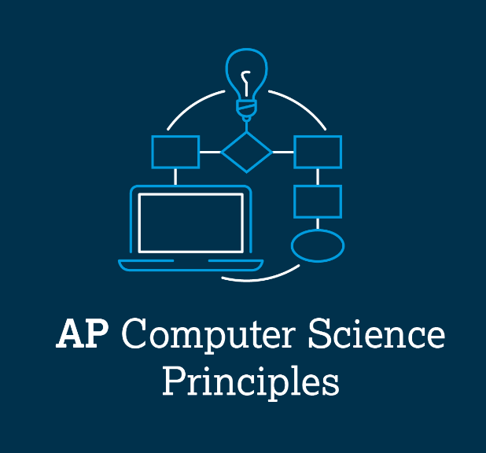
AP CSP Create Performance Task
Part of the AP Exam is to create a program that meets specific requirements:
Creates a list
Uses a list in a meaningful way
Has a function with a parameter
Parameter affects function execution
Function has:
If statement
Loop

Slide 3
AP CSP Create Performance Task
Things to know about the Create PT:
You can work with a partner
Your classmates can help you
Your teacher cannot help you
You cannot use an assigned program for your project, but it can be similar
You will be given 9 hours of class time to work on the project

Slide 4
AP CSP Create Performance Task
The Create PT is like a remix project:
Start small and add components.
Start with what you know.
Don’t try something new that you don’t know how to do.
This isn’t a time to learn something new, but to show what you know how to do.

Slide 5
AP CSP Create Performance Task
The Create PT is like a remix project:
During a remix, you looked at completed programs and reviewed what you learned.
You either added to or created a program similar to your completed programs.
You can do the same thing for the Create PT.
Let’s look at a program from a mission and remix it to meet the requirements of the Create PT.

Slide 6
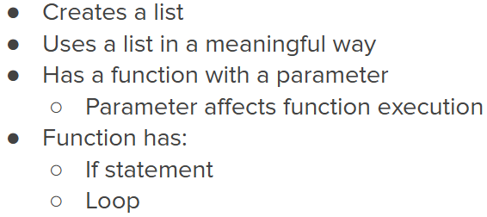
Practice #1
In CodeSpace, go to the Sandbox.
Open the project: LineSense_loops
Go to File Save As… and rename the file PT_CodeBot_Practice1
Review the code.
What PT requirements does it meet?
What PT requirements does it lack?

Slide 7
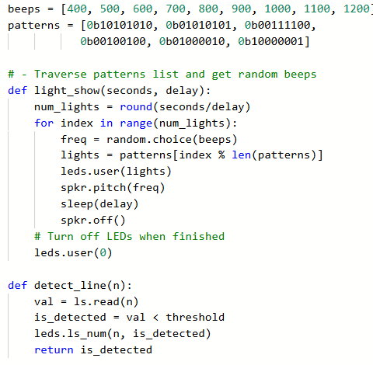
Practice #1
PT Requirements
Creates a list
Uses a list in a meaningful way
Has a function with a parameter
Parameter affects function execution
Function has:
If statement
Loop

Slide 8
Practice #1
This project meets most of the requirements.
By adding just a few lines of code, the program can meet all the requirements.
Can you think something to add to the program to meet the requirements?
Go to the Activity Guide and write down some possible program modifications.

Slide 9
Practice #1
There are many things you can do!
One way is to add an if statement to the function.
The function already has a parameter, so adding an if statement using one of the parameters is an easy way to meet the requirement.

Slide 10
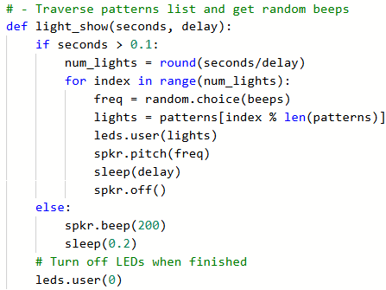
Practice #1
Return to PT_CodeBot_Practice1
Add an if statement using a parameter.
There are many possibilities.
The example shows one of them.

Slide 11
Practice #1
You should be able to explain what the if statement does.
You should be able to give a parameter that makes each branch of the statement run.
On your activity guide, answer the questions.

Slide 12
Practice #1
Possible answer for this example:
1st parameter: light_show(1.3, 0.1)
The seconds are greater than 0.1, so the num_lights list is traversed using a for loop. A random beep is selected and the lights turn on and the speaker beeps for delay seconds.

Slide 13
Practice #1
Possible answer for this example:
2nd parameter: light_show(0, 0.1)
The seconds are less than 0.1, so the speaker plays a low beep for 0.2 seconds.

Slide 14
Practice #1
You might remember that you don’t call the function with a 0 argument for seconds.
That is okay.
The if statement still shows procedural abstraction.
As long as you can explain the code, it is fine.

Slide 15
Practice #1
Look at your code again. Does it meet all requirements?
Creates a list
Uses a list in a meaningful way
Has a function with a parameter
Parameter affect function execution
Function has:
If statement
Loop

Slide 16
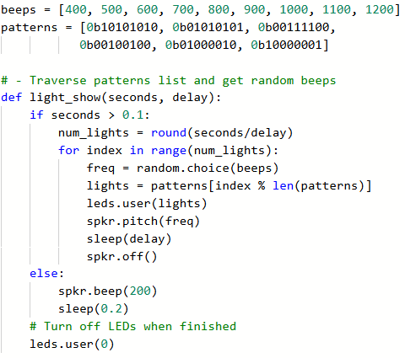
Practice #1
You should be able select code that shows a list being created and the same list being used.
You can use either list.

Slide 17
Practice #1
Example with the beeps list.
v

Slide 18
Practice #1
Example with the patterns list.

Slide 19
Practice #1
Now that you have seen an example of modifying the LineSense program, can you think of any other ways to remix the project for the Create PT?
Go to the Activity Guide and write down any more ideas you have for modifications.

Slide 20
Practice #1
Final considerations.
Your program needs to have input and output.
Can you explain the input and output of this program?
Your program needs to have a purpose and intended users.
Can you explain the purpose of the program? The purpose is the “why” – what problem does the program solve?
Can you explain the function of the program? The function is what it does – like stay within the bounds of lines.
Can you explain who the intended users are?

